Slide 1
The Battle of Neighborhood: Clustering Localities in Kochi City

Slide 2

Clustering Localities
Clustering restaurants based on cost and ratings
Important data for travelers who are visiting the place for first time
Helps in making budget friendly decisions
Helps investors and entrepreneur to study the locality for setting up the business.

Slide 3
Data Collection and Cleaning
Venue details in Kochi city is collected via Foursqaure API
Restaurants details associated with a venue is retrieved via Zomato API
Duplicate restaurant details are removed
Restaurants having review and review count as zero are removed

Slide 4
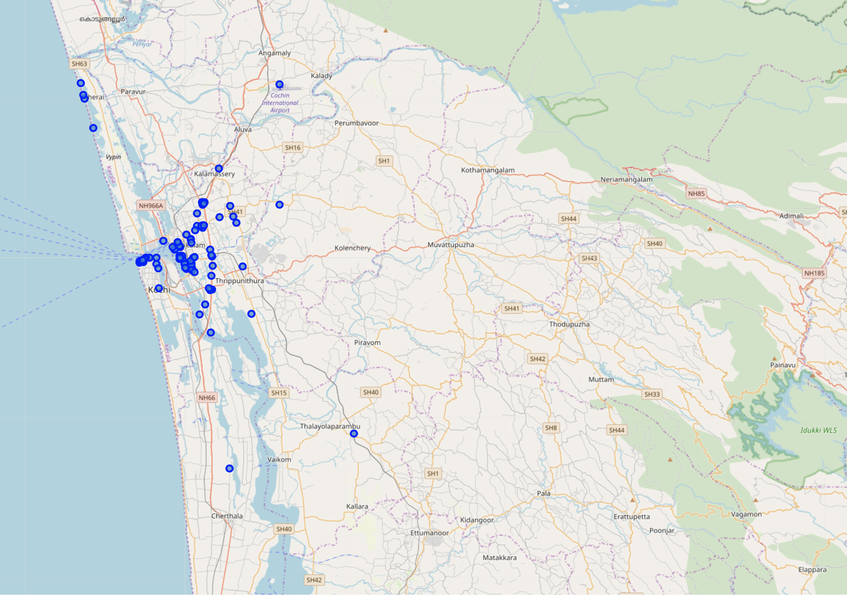
Kochi City Venues
94 Venues in 30km radius

Slide 5
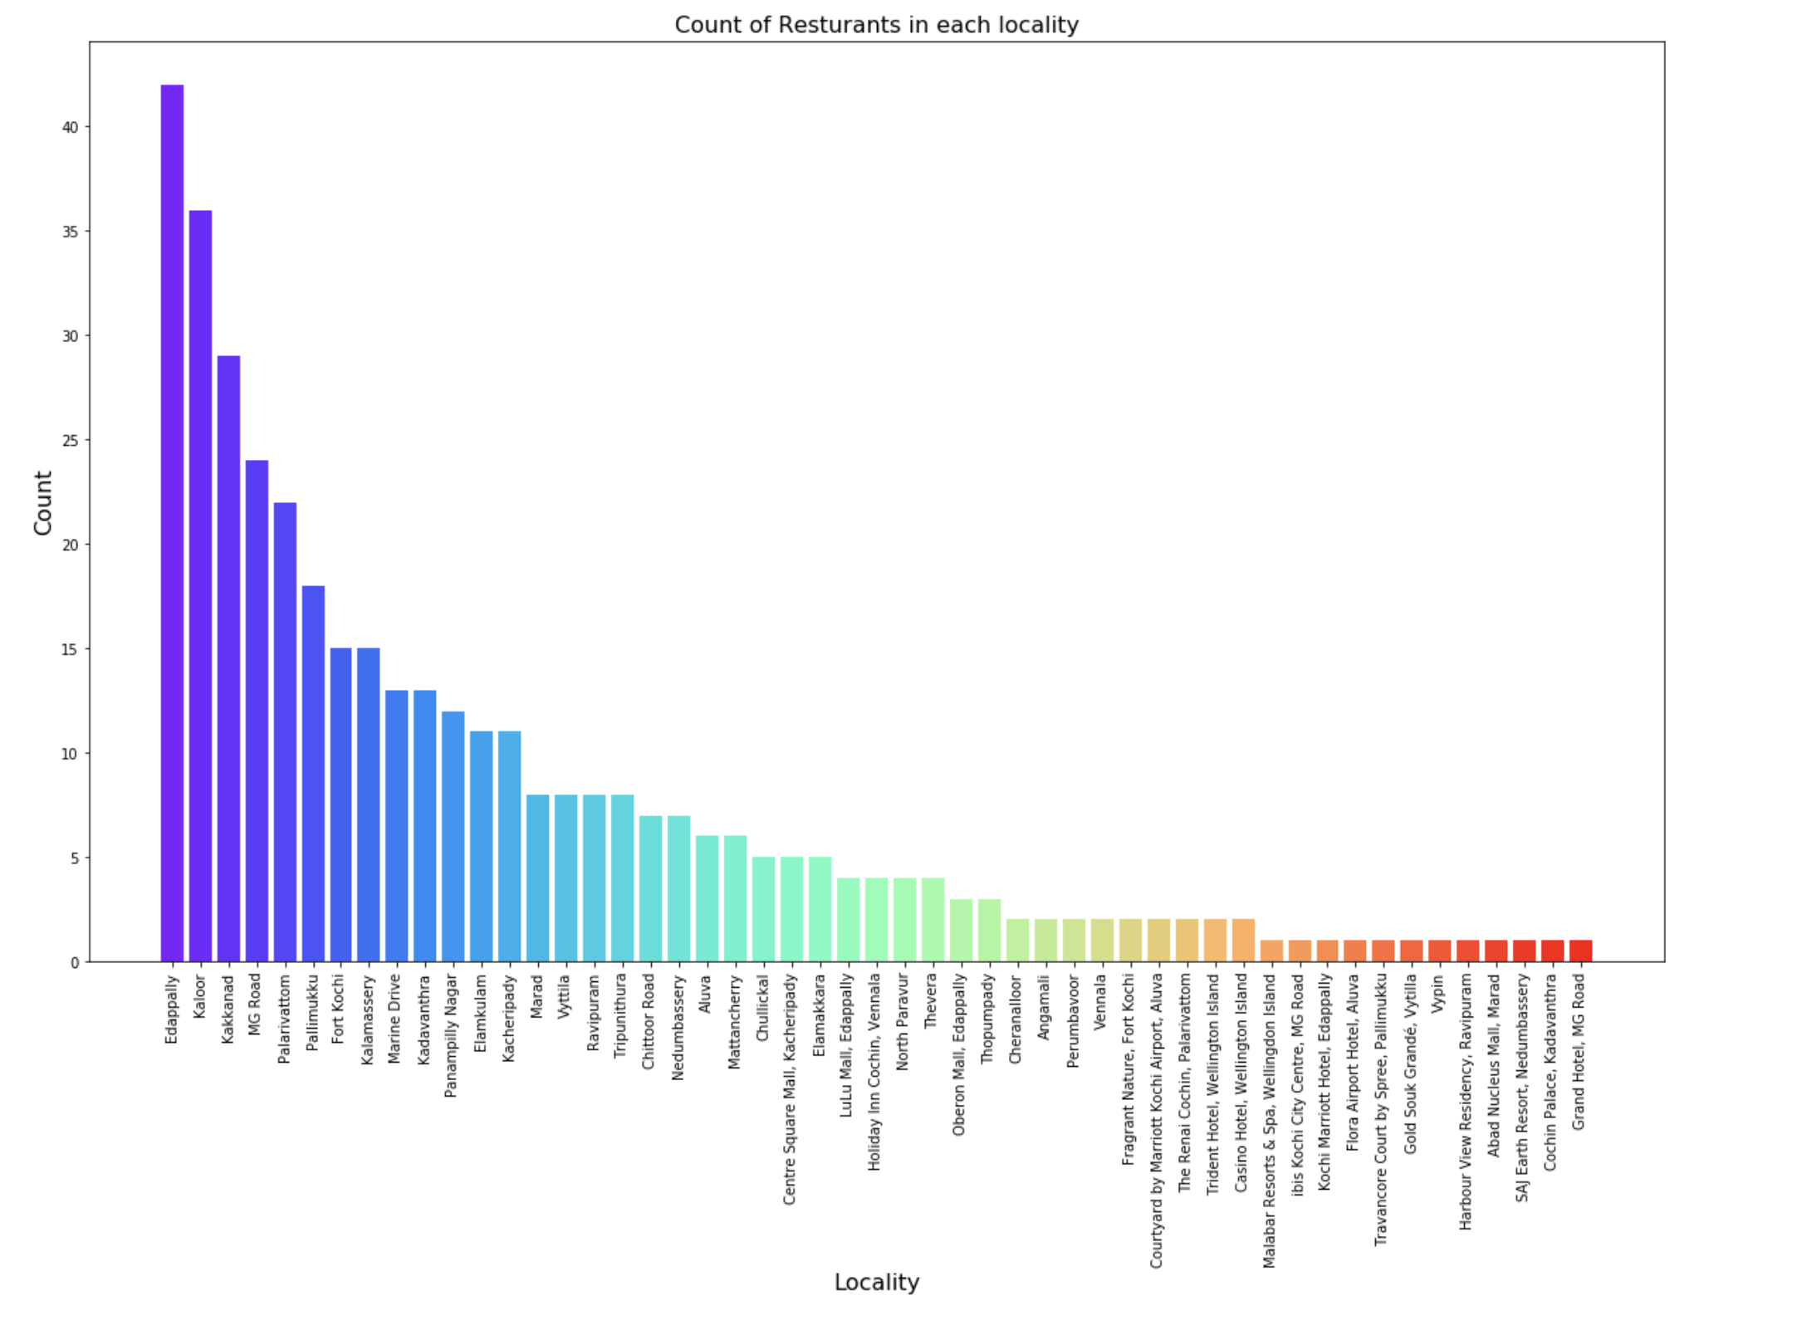
Restaurant Counts per locality
Edappally and Kaloor with most restaurant counts

Slide 6
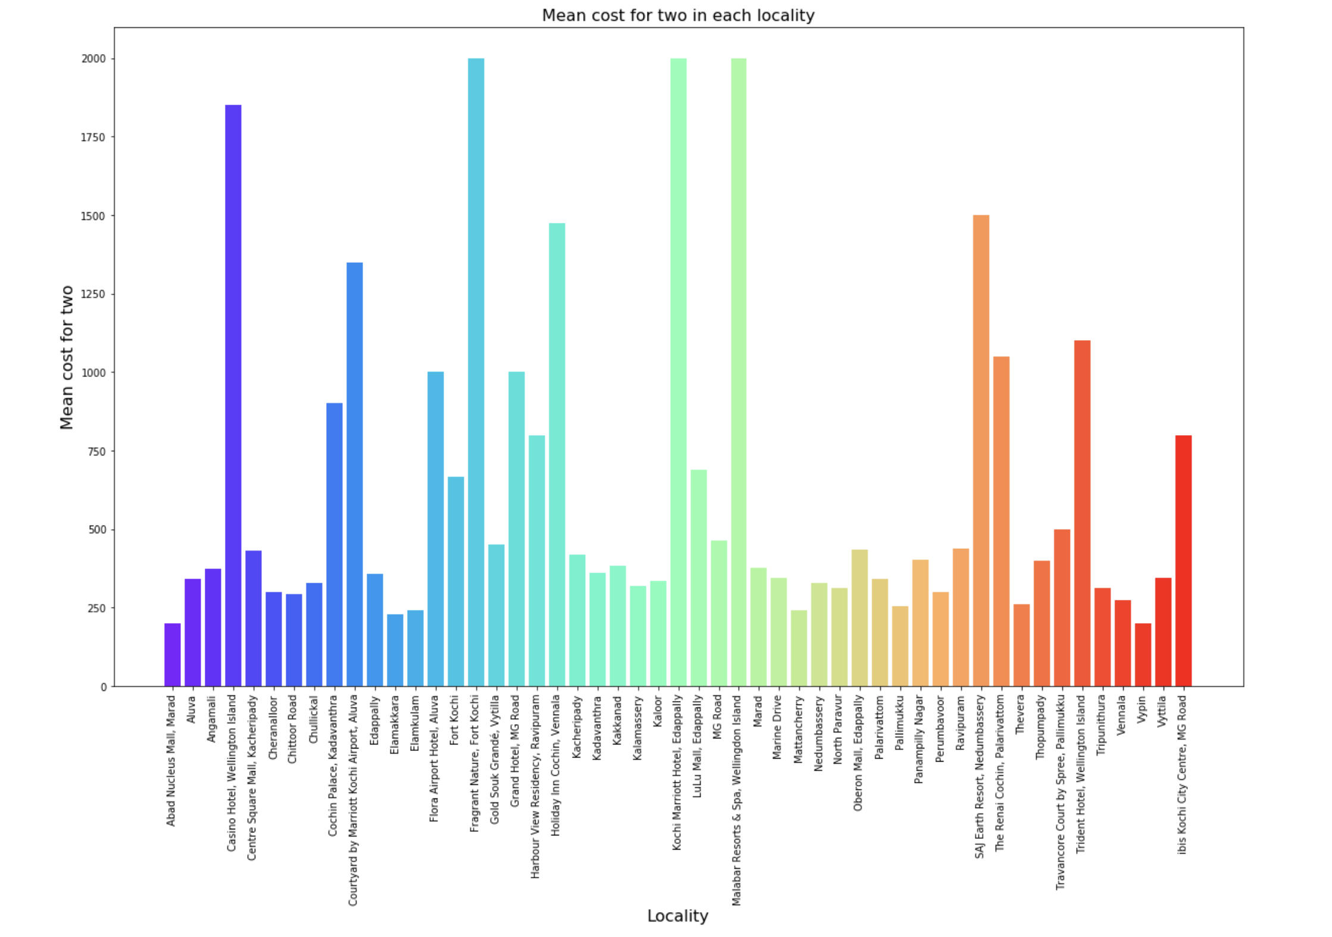
Average cost for two
Costlier restaurants are;
Kochi Marriott Hotel Edappally,
Fargrant Nature FortKochi
Malabar Resorts & Spa, Wellingdon Island

Slide 7
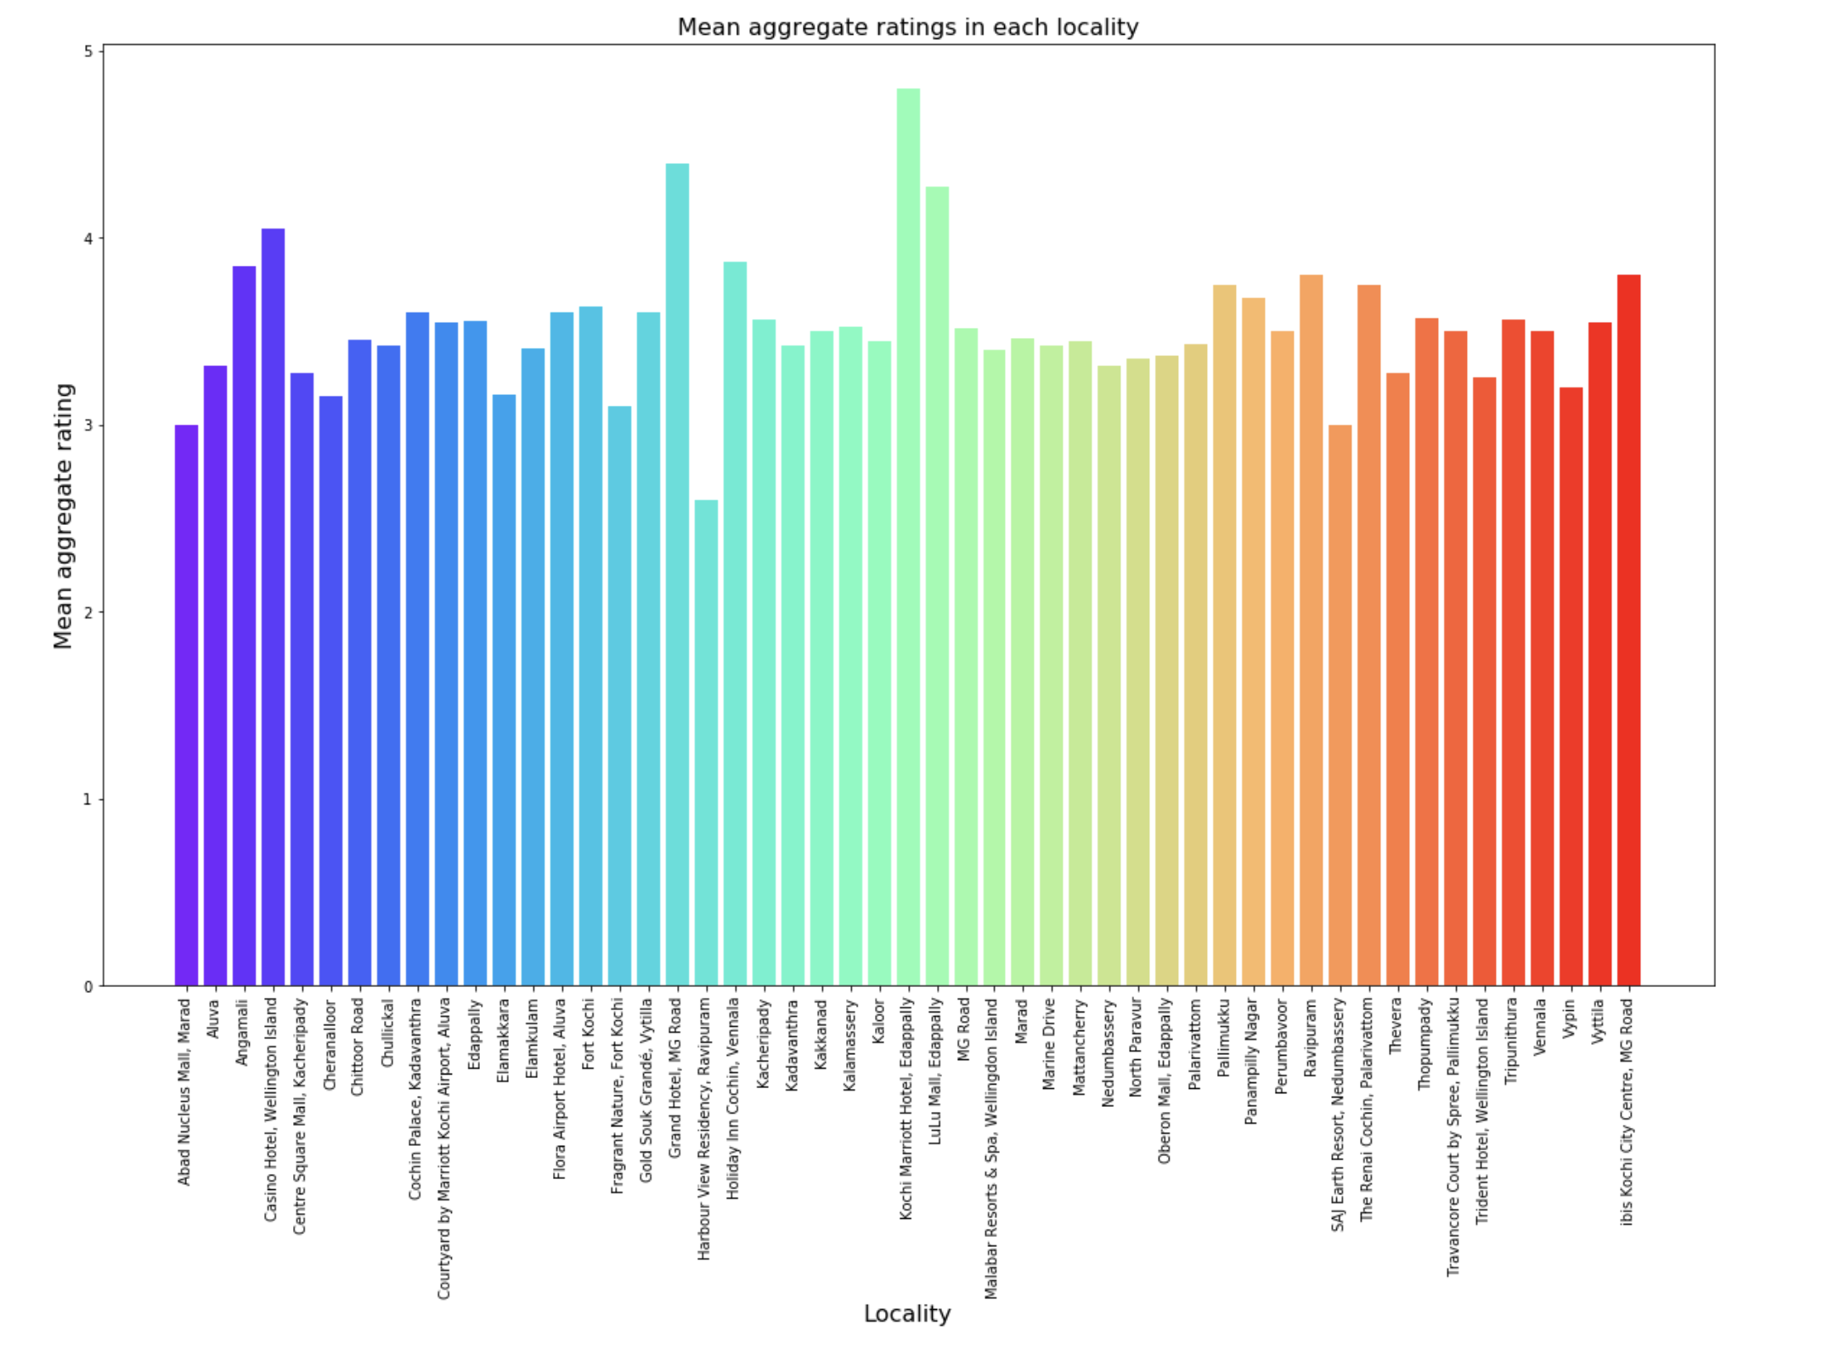
Aggregate Ratings in Localities

Slide 8
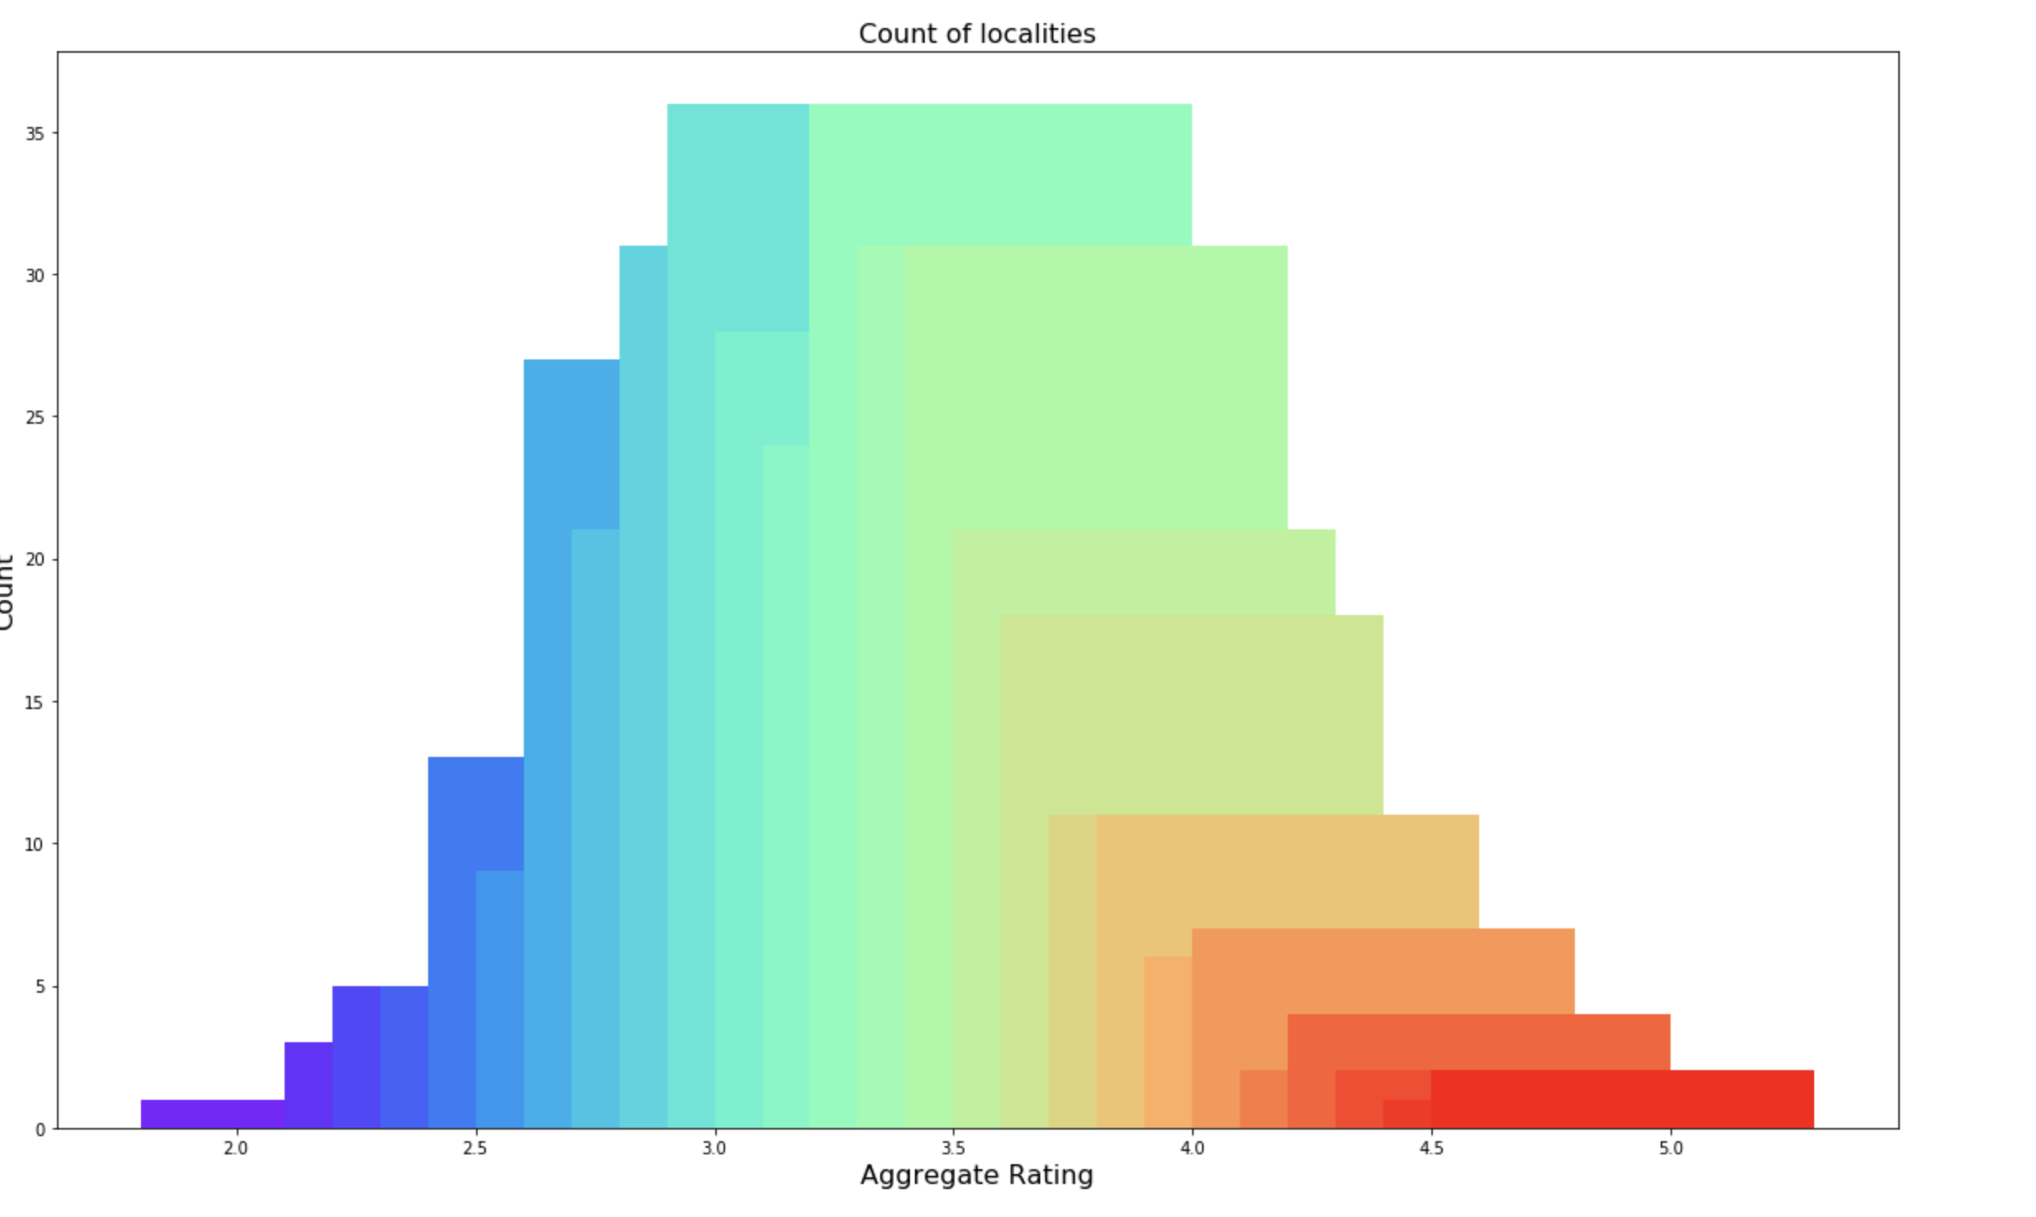
Restaurants Qaulity
Most restaurants in Kochi has good ratings(>3.5)

Slide 9
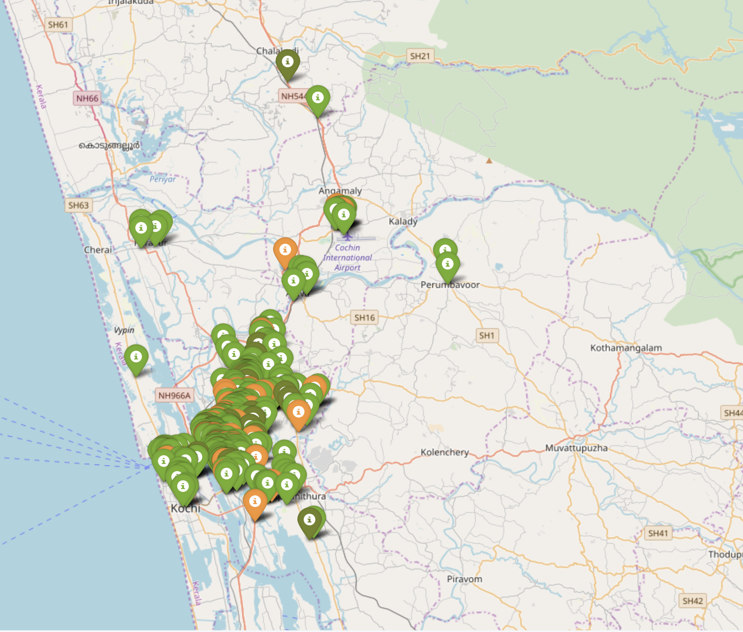
Geolocation based on ratings
color_map = {'Very Low': 'red', 'Low': 'orange', 'Good': 'green', 'Very good': 'darkgreen'}

Slide 10
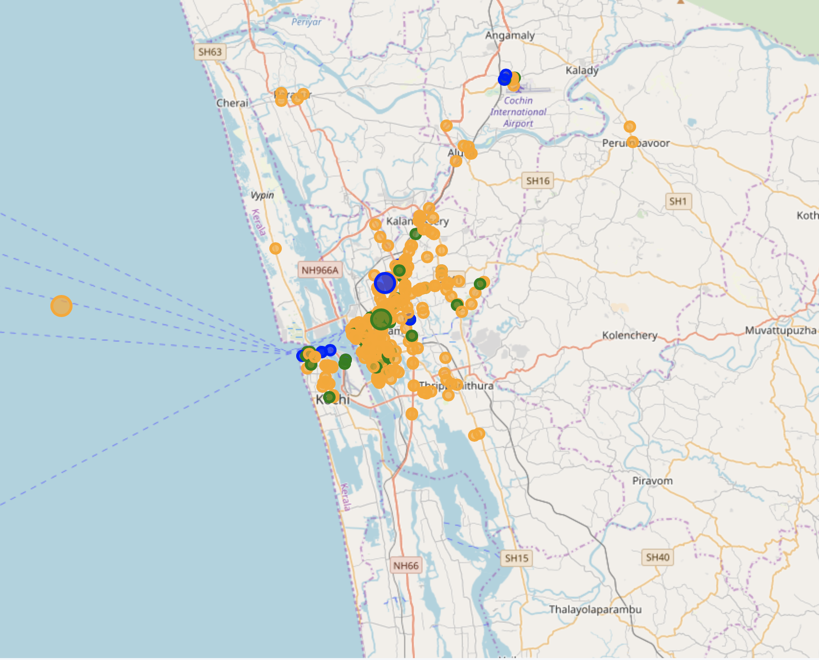
K-Means Clustering
K = 3
Clustering based on aggregate rating and cost for two
Cluster-2: avg cost for two = 306 and rating = 3.48
Cluster-1: avg cost for two = 807 and rating = 3.68
Cluster-3: avg cost for two = 1930 and rating = 3.71
Most of the localities in centre of kochi city is falling under cluster-1.
Most expensive localities in Kochi have good customer ratings.

Slide 11
Conclusion and Future Directions
Clustering and data analysis helps to plan travelling budget
Helps investors and entrepreneurs to take right decision
Locality Kaloor finds to be budget friendly
Most of the eateries available in Kochi has good customer rating
Data analysis can be improved by coupling with census data of Kochi
Data cleaning needs improvement
Analysis along with restaurant category helps entrepreneurs better

